Slide 1

Domain:
Artificial Intelligence
Problem Statement Title:
Medical chatbot(Mr.Dbot)
UN Sustainable Development Goal :
3. Ensure healthy lives and promote well-being for all at all ages
21IT024-Ayush Dave
21IT019-Dishant Chauhan
21IT010-Parmesh Bhat

Slide 2
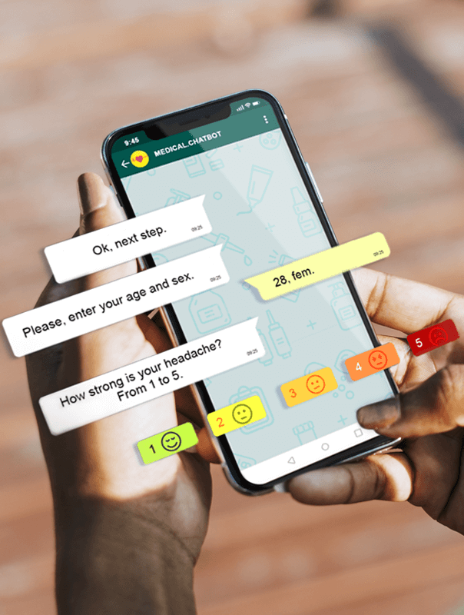
Idea Details for medical chatbot
The main premise behind these talking or texting smart algorithms is to become the first point of contact before any human involvement is needed.
This chatbot offer a personalized approach to every user; in ways that can be more convenient, and efficient that they surpass human capabilities.
All healthcare providers are always willing to help their patients, but the overwhelming workload doesn’t always let them provide the best service. A 21st medical practice can rely on a chatbot to ensure 24/7 availability, answer repetitive questions, or schedule appointments.

Slide 3
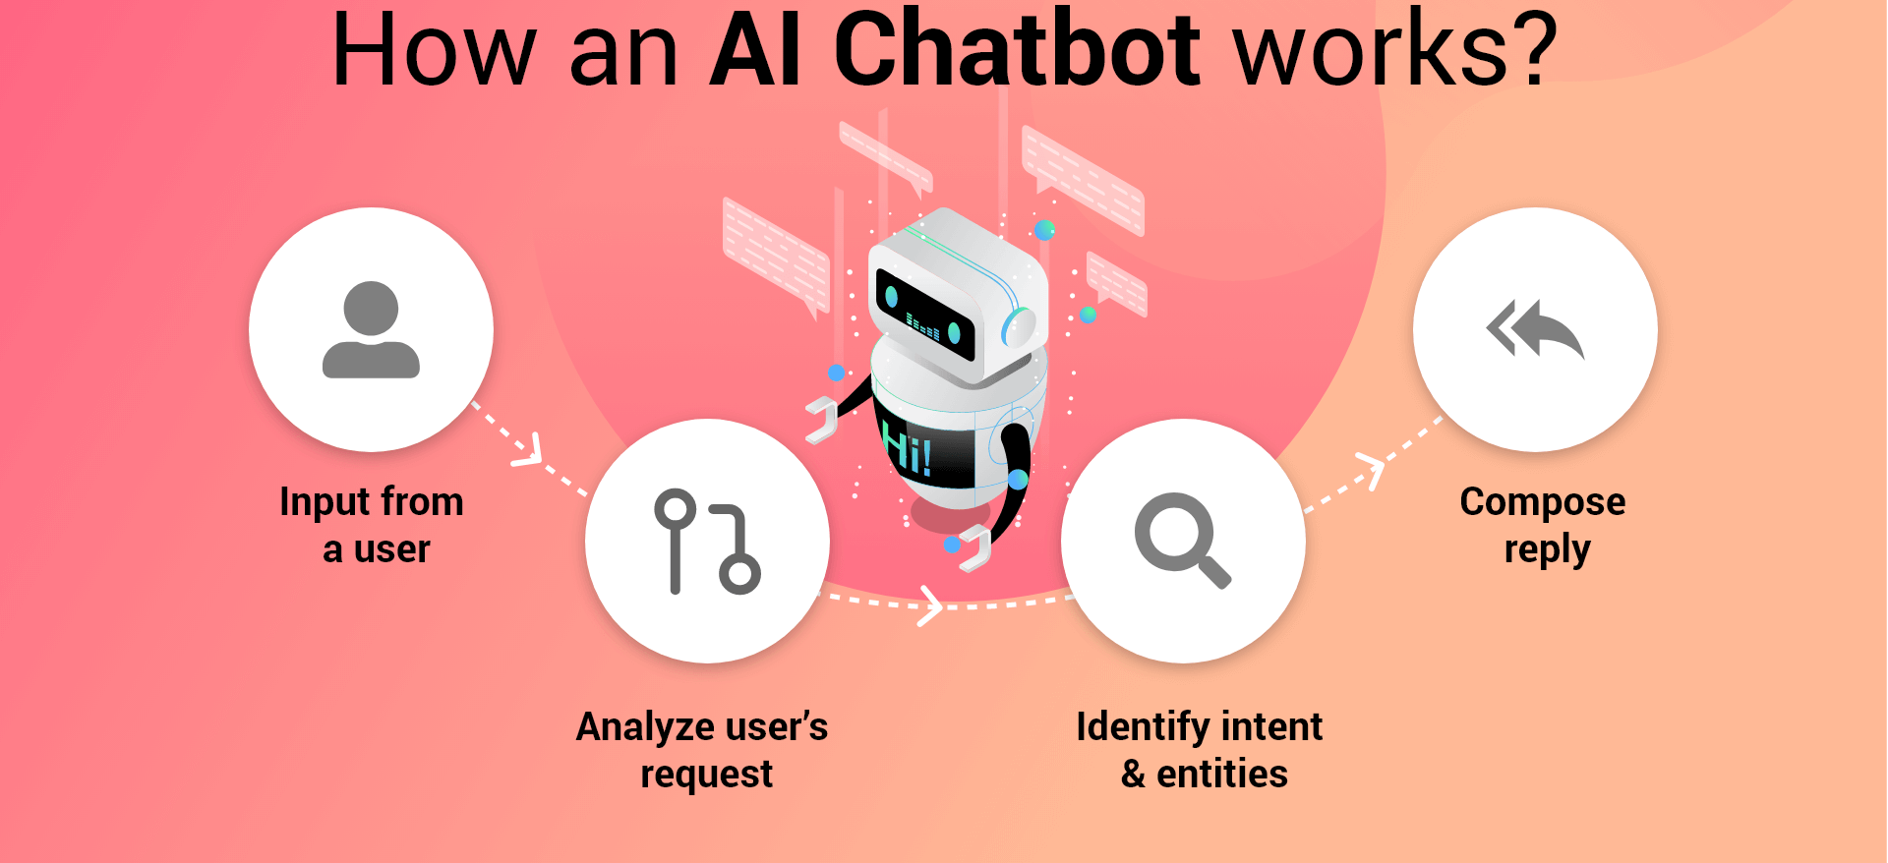
Idea Details

Slide 4
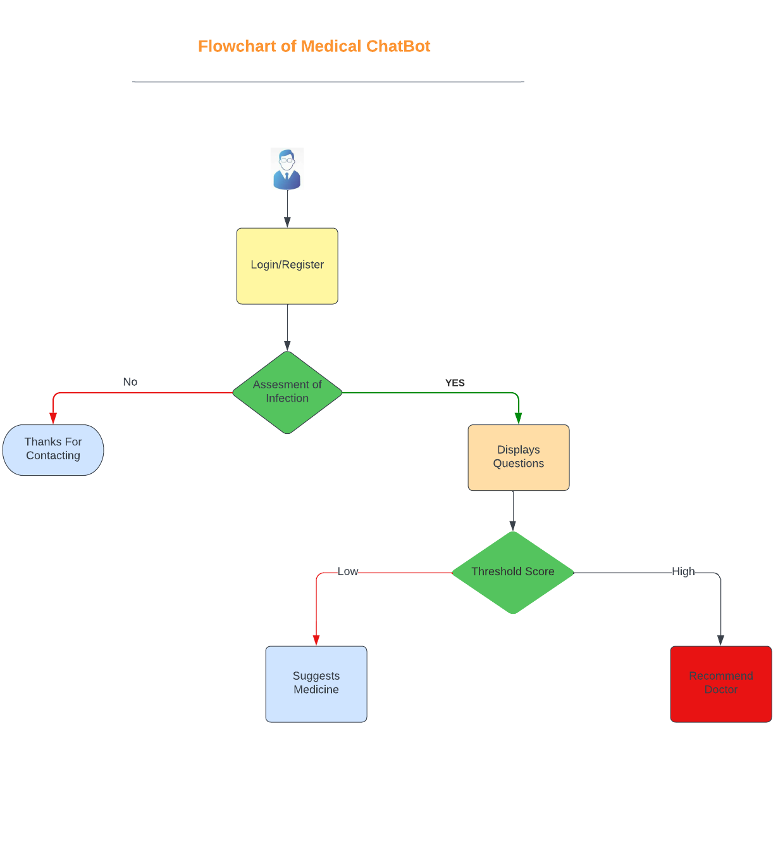
Flowchart for Medical Chatbot

Slide 5
Business Potential
The Global Healthcare Chatbots Market is projected to expand rapidly throughout the projected period. The key growth drivers for the Healthcare Chatbots Market are the increasing use of smart devices like phones and tablets, and also the rising adoption of chatbots in the medical sector.
Increasing demand for virtual health assistance is a critical factor driving market growth, as these are increasing constant advancements and technological developments in the industry, an increase in patient waiting time and a shortage of effective patient engagement

Slide 6
Future Scope of Healthcare Chatbot
The future of AI in health care could include tasks that range from simple to complex—everything from answering the phone to medical record review.
Chatbots guide people rightly for serious illness and also assists them in scheduling appointments with professionals as well as Chatbots reduces the work load of doctors.
People expect medical professionals to provide a quick response to their queries. Delays in responsiveness can lead them to lose trust in the brand they're seeking assistance from. Chatbots give a hand in taking care of customers' queries and issues anytime. They make instant responses and resolve the case on a chat.

Slide 7
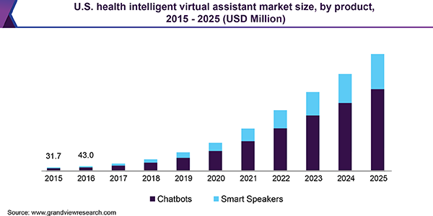
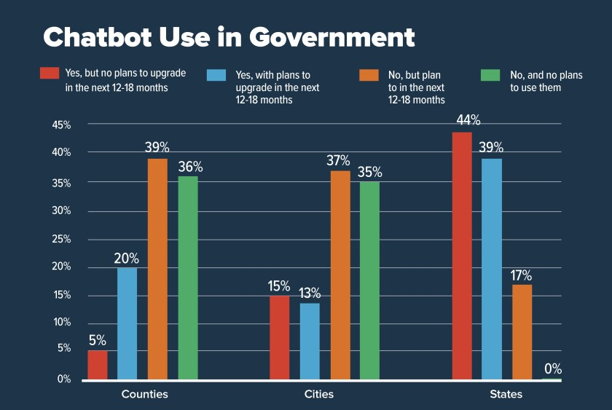
Graph of Healthcare Chatbot

Slide 8
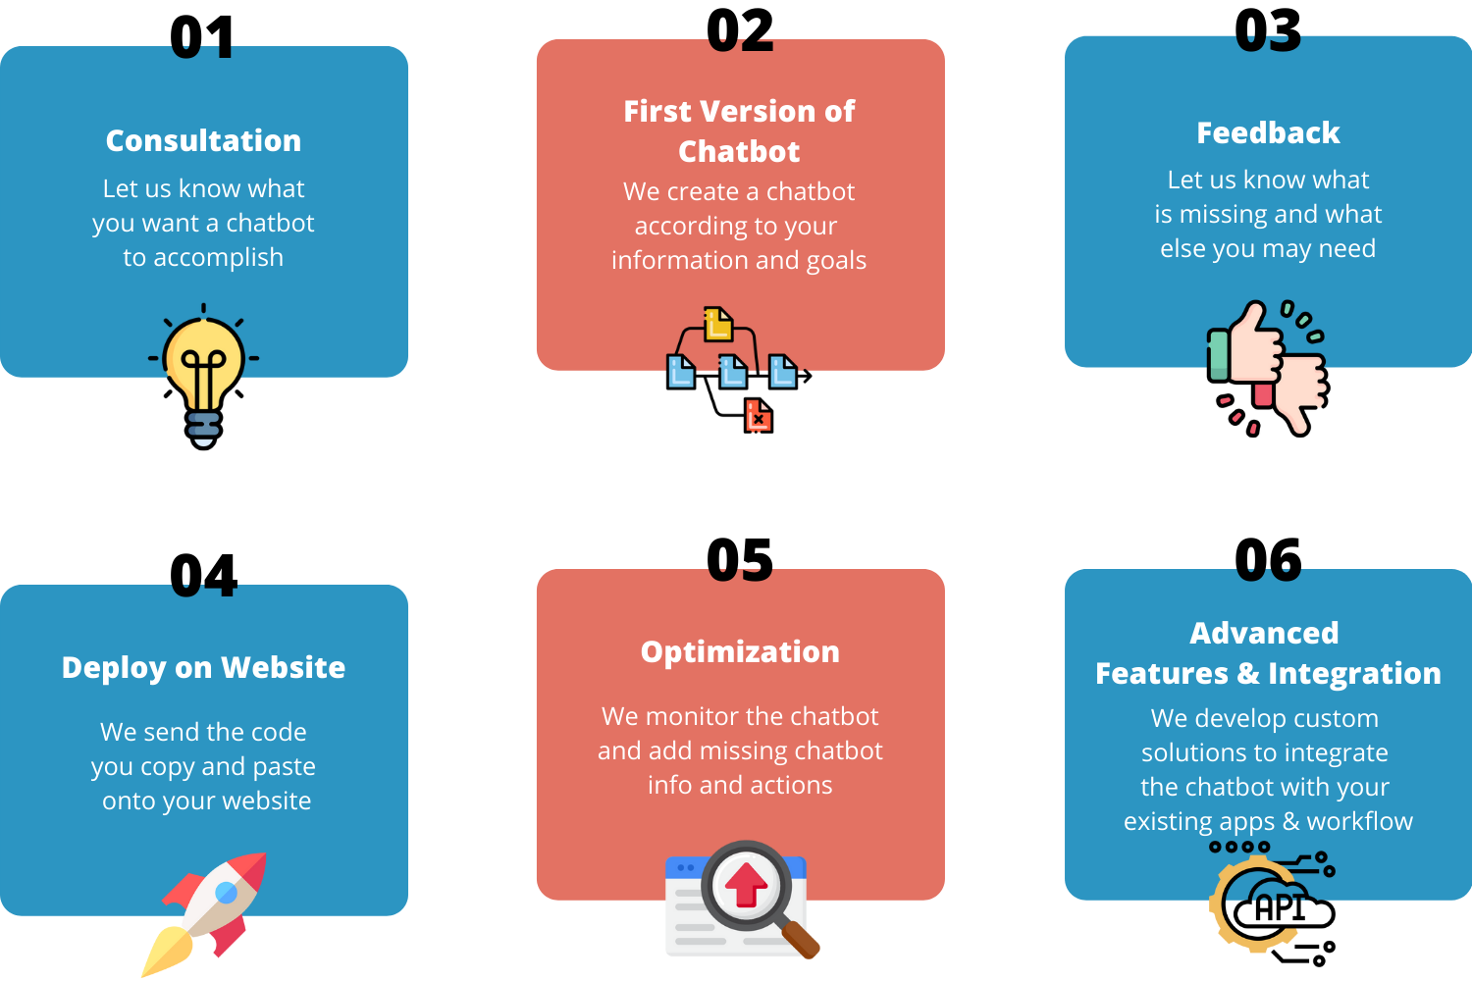
How Healthcare chatbots will help us?

Slide 9
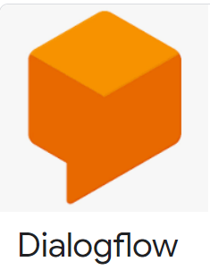
Implementation Strategy
For the project implementation, we have used the technology named “Dialogflow”.
Dialogflow is a natural language understanding platform that makes it easy to design and integrate a conversational user interface into your mobile app, web application, device, bot, interactive voice response system.

Slide 10
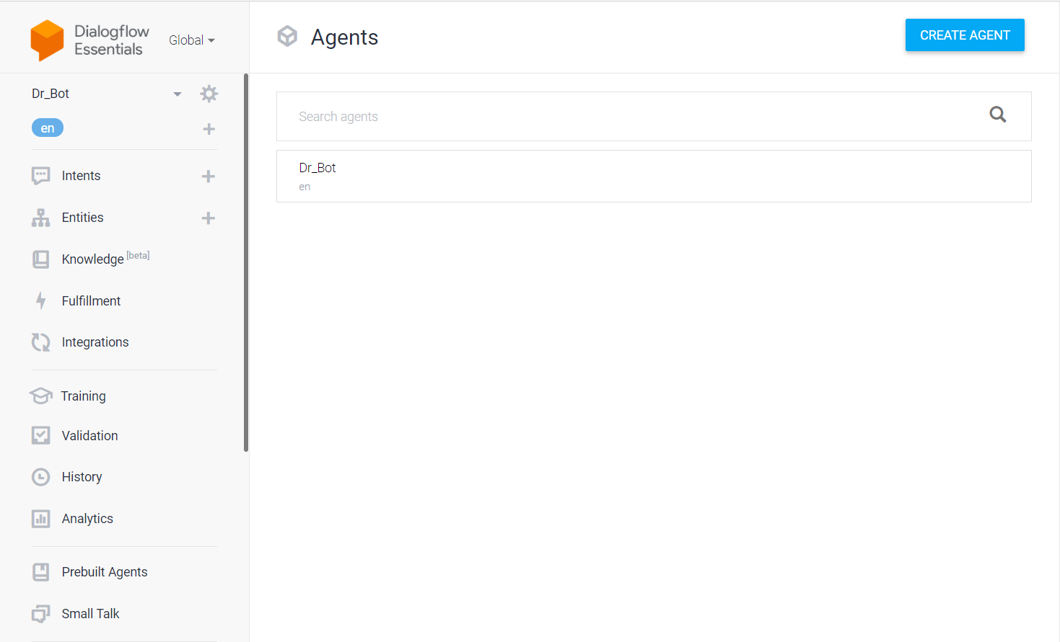
Implementation Strategy
For the project implementation, we have used the Dialogflow technology and in that we have created a new agent to implement the chatbot.
In it there are two options first is the intent and other is the entities option where we have created the conversation between the bot and the patient.

Slide 11
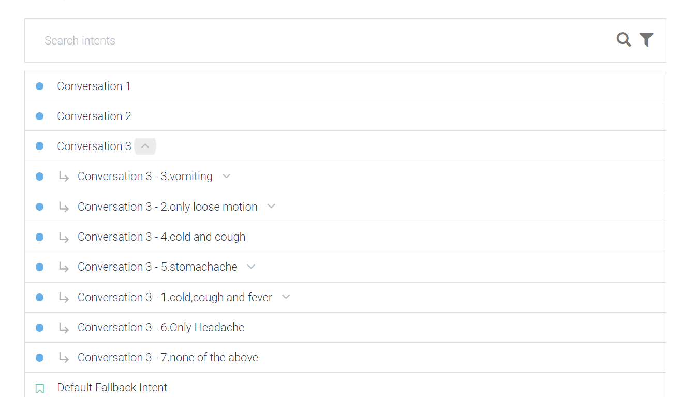
Implementation Strategy

Slide 12
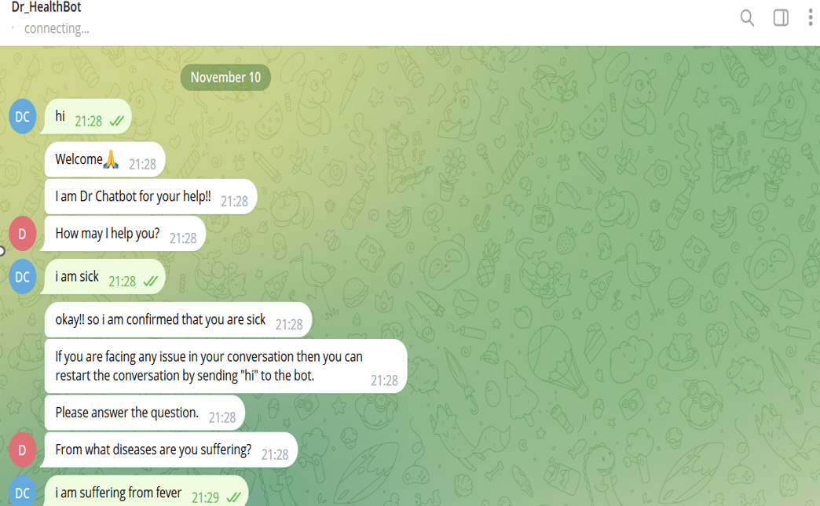
Working of Our Medical Chatbot
The given image illustrates about the introduction of our chatbot where we finds that chatbot is asking a question about your condition.

Slide 13
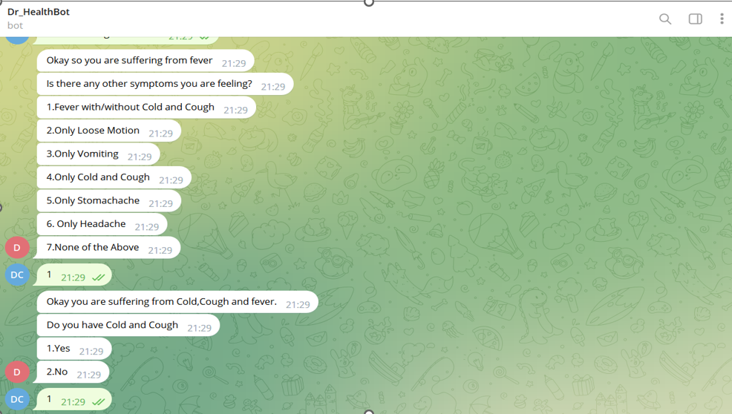
Working of Medical Chatbot
Then bot will ask you further some questions like what are the other symptoms you are feeling, from what days you are sick, is there any improvement seen in your health etc.

Slide 14
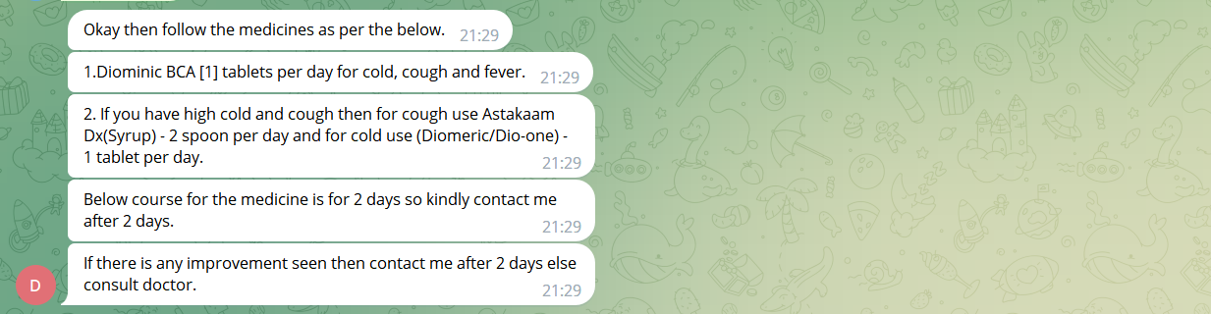
Working of Medical Chatbot
After all the questions it will suggests you medicine or home remedies depending upon your health condition.

Slide 15
Conclusion
All thanks to healthcare chatbots, even during the pandemic, patients can reach practitioners at the time of need. Using Conversational AI for the healthcare industry makes it easy for patients to access healthcare during emergencies, no matter where they are located.

Slide 16
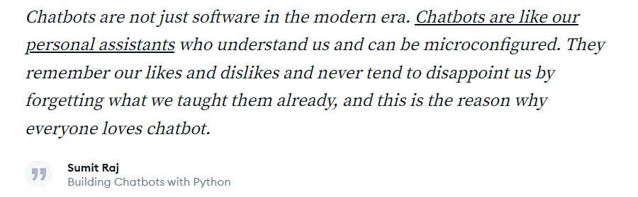

Slide 17


